Slide 1
You Down with RTT? Making Real-Time Text Accessible to Deaf-Blind Users
Presented By:
Sam Joehl • Level Access
Matt Myrick • AT&T
CSUN 2018 Assistive Technology Conference
March 23, 2018

Slide 2
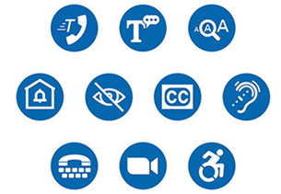
Real-Time Text Topics
You Down with RTT?
What is Real-Time Text (RTT)?
RTT Timeline
AT&T and Real-Time Text
Making the RTT App Accessible
Best practices for making RTT accessible to users who are Deafblind

Slide 3

What is Real-Time Text?

Slide 4


What is Real-Time Text (RTT)?
Overview
Real‐Time Text (RTT) is a text-based mode of communication where each text character appears on the receiving device at the same time it is being typed on the sending device, allowing for a conversational flow of communication, simultaneously with voice.
Benefits of RTT:
Communicate simultaneously
Is a key component of Total Conversation
IP-based text form of communication; TTY is not.
Is backwards compatible with TTY and will replace TTY as it is phased out.
Words are received immediately as they are typed.
Provides functional equivalence for a text message to a speech conversation.
Critical for emergency situations where the user may unable to finish their message or time is of essence.

Slide 5
The Comparison: TTY and RTT
The TTY Characteristics versus RTT
Characteristic | TTY | RTT
Voice and text in real time, simultaneously (VCO/HCO) | Yes | Yes
Character-by-character | Yes | Yes
Standards-based | Yes | Yes
Widely implemented | Yes | No
Full duplex | No | Yes
Works over various access technologies | No | Yes
Internal keyboard | No | Yes
Resilient to IP network conditions | No | Yes
Efficient use of network resources | No | Yes
Foreign languages and special characters | No | Yes
Support for users with hearing/speech disabilities | Assistive Technology | Accessible Technology

Slide 6

RTT Timeline

Slide 7

History of TTY
The TTY Problem
TTY is an analog technology that converts text to audio tones which are sent over the phone network
As phone networks convert from analog, copper switch networks to digital, packet switch networks, TTY has become less reliable to transmit
Several factors of digital networks can cause packet loss which disrupts the ability to send TTY:
Compression techniques used by digital audio codecs
Echo cancellation
Bandwidth issues

Slide 8
The TTY Issue
RTT Timeline
FCC rules require telecommunications services providers and service providers of Advanced Communications Services to support TTY communication
On June 12, 2015 AT&T filed a petition with the FCC
The petition requested that the FCC issue a rulemaking to replace TTY with real-time text within the IP environment
The petition also requested that the FCC grant AT&T a waiver from the TTY requirements for cellular devices within IP environments until the rulemaking was completed
A temporary waiver was granted to AT&T on October 6, 2015 for the period until December 31, 2017
Similar waivers were also granted to Verizon Wireless and members of the Competitive Carriers Association among others.

Slide 9
FCC Rulemakings on RTT
RTT Timeline
On December 15, 2016, the FCC adopted new rules to facilitate the transition from TTY to real-time text technology
Allow wireless providers and handset manufacturers to use real-time text to meet their TTY obligations
Require users of RTT to be able to reach emergency services (911) and Telecommunications Relay Services (711)
Standardizes on the RFC 4103 protocol for real-time text to permit interoperability across carriers and devices
Requires RTT to be backwards-compatible with TTY communication
Establishes a phased roll-out schedule for wireless networks between December 2017 and June 2021
The Commission also issued an accompanying Further Notice of Proposed Rulemaking to seek comment on issues not addressed in the rules:
A timeline to retire the requirement for RTT to be backwards-compatible with TTY
How to integrate RTT into TRS operations
RTT Features that would be required for individuals with cognitive disabilities and individuals who are deaf-blind

Slide 10

RTT and the Section 508 Refresh
RTT Timeline
On January 4, 2017, the U.S. Access Board updated the ICT Accessibility Standards which refreshed the standards for Section 508 of the Rehabilitation Act and the Section 255 Telecommunications Act Accessibility Guidelines
The board reserved any rulemaking on real-time text until the FCC completes its rulemaking but plans to require real-time text in the future
The Board added TTY requirements back into the updated standards in order to fill the interim gap of telecommunications access for individuals with hearing and speech disabilities which had been left out of the updated standards

Slide 11
The FCC DAC and RTT
RTT Timeline
At its October 16, 2017 meeting, the FCC Disability Advisory Committee (DAC) voted to adopt a recommendation to research best practices for making real-time text accessible to individuals who are deaf-blind.
The recommendation noted several challenges around use of RTT with refreshable braille, including:
Mistranslation of words into contracted Braille before words have finished being sent
Alerting the user when the other party has started and stopped typing
Displaying information from all parties on a single line refreshable braille display
Needing to use one’s hands both for sending and receiving messages sent in both directions
The Disability Advisory Committee will be holding a roundtable at the FCC on April 9 with wireless carriers, phone and assistive technology manufacturers, deaf-blind consumers and accessibility experts to explore these challenges, limitations and potential solutions.

Slide 12

AT&T Real-Time Text

Slide 13


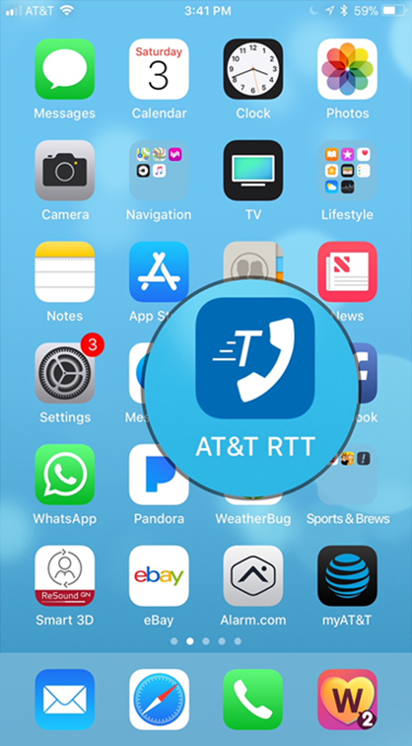
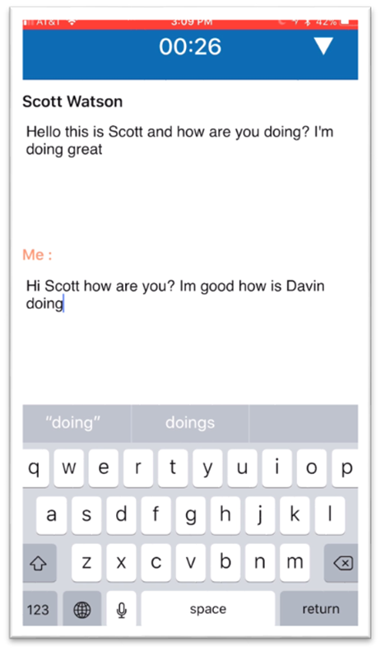
The AT&T RTT App
AT&T and Real-Time Text
In December 2017, AT&T released its Real-Time Text solution to the market.
The solution currently consists of an app that is available for iOS and Android.
AT&T subscribers can download the app for free from the iTunes app or Google Play store and use the solution over the AT&T network or a Wi-Fi connection.
The call is deducted against the subscriber’s voice plan instead of their data plan.
During an RTT call, parties may send text in both directions simultaneously and mix text and speech.

Slide 14

The AT&T Engagement with Level Access
AT&T and Real-Time Text
AT&T contracted with Level Access to test the RTT app for accessibility
Level Access tested a representative sample of screens against relevant accessibility standards including WCAG 2.0, CVAA Advanced Communications Services and Section 255 of the Telecommunications Act
Functional use case testing was also performed by executing core tasks using individuals with hearing and speech disabilities
Testing was performed using iOS VoiceOver, Android TalkBack and BrailleBack, a Focus 40 refreshable braille display and a TTY device

Slide 15
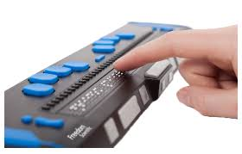

AT&T and Real-Time Text
The AT&T Engagement with Level Access
Using the refreshable braille display, Level Access was able to identify information that was spoken by the screen reader that did not appear on the braille display
Level Access provided AT&T with frequent reports containing accessibility violations which were then fixed by the app developer
Level Access then performed some regression testing to verify that the violations had been fixed in subsequent builds of the app
While not perfect, accessibility improvements have been made to the RTT app and AT&T is aware of any outstanding issues that were addressed and fixed.

Slide 16

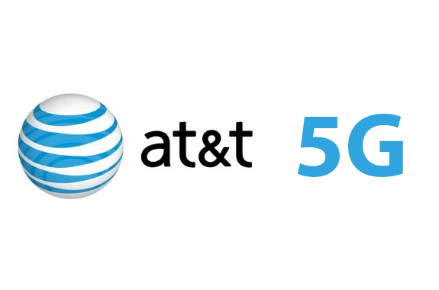
RTT Inclusion
5G and IoT
5G connectivity is around the corner and it will be crucial for RTT to be a part of the transformation.
Benefits of 5G technology:
Will move more data or increased speed
To be more responsive or ultra low-latency
The ability to connect a lot more devices at once or for sensors and smart devices.
By 2020, traffic volumes will be multiplied by 1000 times.
RTT has the capabilities to integrate with other devices and platforms so it can prioritize a quick response.

Slide 17
Best Practices for Making RTT Accessible to Deaf-Blind Individuals

Slide 18
Explicitly Declare Accessibility Labels
Best Practices for making RTT Accessible to Deaf-Blind Individuals
During testing, Level Access found instances where an element’s label was spoken but did not immediately appear on the braille display
Testing suggested that this occurs when an accessible label is not explicitly declared for an element
Once the label was explicitly set, the issue appeared to resolve.

Slide 19
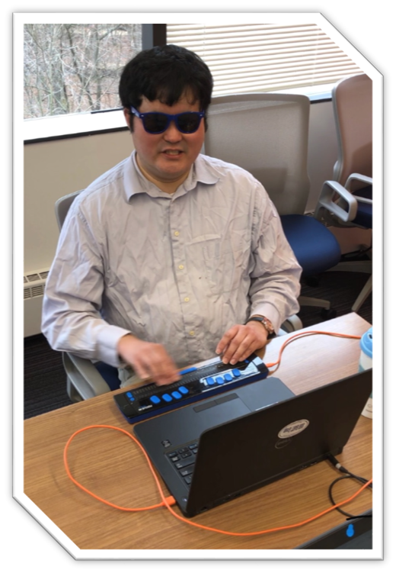
Allow the User to Maintain Control of Focus
Best Practices for making RTT Accessible to Deaf-Blind Individuals
Since refreshable braille displays can currently only show a single line of text at one time (up to 40 characters), content can only be reviewed linearly
Since all parties can send messages simultaneously, users of refreshable braille must maintain control over which message is shown on the display at any given time, and focus must not shift without explicit user action
Provide a mechanism to allow the user to set focus to the desired message (the message they are composing or content being received from the other party)

Slide 20

Notify When Other Party Starts/Stops Typing
Best Practices for making RTT Accessible to Deaf-Blind Individuals
If no alert is provided when new content is being received, the user will have to frequently check the incoming message area for the arrival of new content.
This could result in incoming content being missed by the user.
Since characters are displayed as soon as they are typed, alerts should not be fired every time new content arrives as this would be extremely intrusive.
Ideally, provide options to allow the user to configure the frequency and verbosity of notifications.

Slide 21

Programmatically or Textually Label Regions Identifying Content From Each Party
Best Practices for making RTT Accessible to Deaf-Blind Individuals
If color or other visual styling is used to separate content from each party in the conversation, users of screen readers will not be aware of this separation of content.
Label each message or each pane programmatically or with text so that screen readers will identify the party that sent the message.
If all messages are displayed in a single pane, each message will need to be labeled with the party that sent it.
If content from each party is displayed in separate panes, provide a label for each pane so the user knows which party the pane applies to.

Slide 22

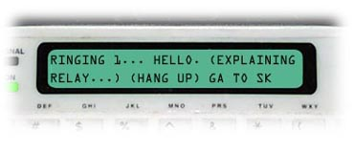
Implement a Turn-Taking Mode
Best Practices for making RTT Accessible to Deaf-Blind Individuals
The ability for text to be sent in both directions simultaneously poses the challenges just discussed as part of these best practices
Implementing a half-duplex mode where one party can communicate at a time eliminates some of the challenges of monitoring multiple areas of the screen at once
Turn-taking can be a technology solution, or it can be an agreed-upon protocol between the parties in the conversation

Slide 23
Resources

Slide 24



Useful Links
Resources
Accessibility Laws and Standards
FCC on Real-Time Text FCC:
AT&T Real-Time Text
AT&T Wireless Accessibility Plans

Slide 25




Thank You
Contact Us
Sam Joehl, Level Access
Sam.Joehl@levelaccess.com
Principal Technical Consultant
Matt Myrick, AT&T
mm9628@att.com
Lead Accessibility Solutions Engineer
Follow Us
@LevelAccessA11y
Level Access
Level Access
Level Access Blog
Slide Deck Available for Download at: https://www.levelaccess.com/csun18/

